Slide 1
Becoming a Compassionate Presence

Slide 2
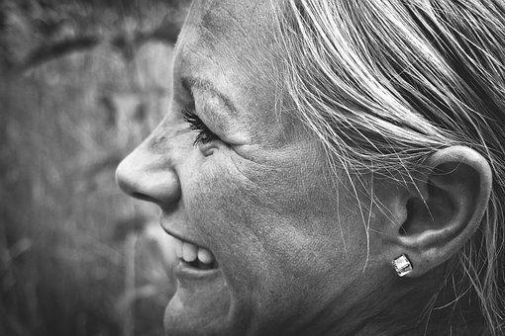
The Body of Compassion
I pray to be the face of compassion –
that those who come within my view
find a cordial, kindly reception
written upon my facial landscape.
I pray to be the ears of compassion –
that those who come filled with distress
will experience my attentive presence,
ready to listen without distraction.

Slide 3
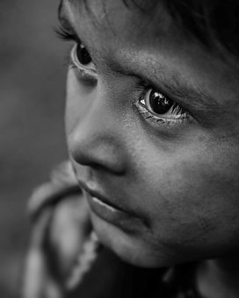
I pray to be the eyes of compassion –
that those who lack society’s support
will receive my non-judgmental gaze,
a look of unbiased, heartfelt welcome.
I pray to be the shoulder of compassion
that those who come laden with burdens
will be able to set things down for a while,
and have the load lightened when they leave.
I pray to be the heart of compassion –
that those who feel overwhelmed with suffering
will sense my empathic response,
one that forgoes a desire to fix the hurt.

Slide 4
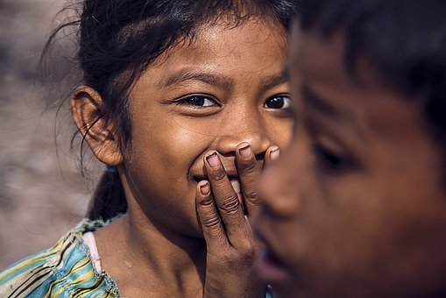
I pray to be the mouth of compassion –
that those whose voice is not heard
will be empowered and supported
by my determined, vocal stand for justice.
I pray to be the hands of compassion –
that those whose life could benefit
from my presence and my actions
will be assisted by the humble offering.

Slide 5
I pray to be the feet of compassion –
that those who long for companionship
will see that I walk beside them,
joined in the strength of a common humanity.
I pray that the light of compassion shining in my soul will recognize and receive the Light shining in others,
that together we will care for creation with respect
and have gratitude for all that exists.
Taken from Prayers of Boundless Compassion
© 2018 by Joyce Rupp.
Used by permission of Sorin Books.
All rights reserved.

Slide 6
A Compassionate Presence “…an attitude of the heart, one which approaches life with serene attentiveness, which is capable of being fully present to someone without thinking of what comes next…” Laudato Si 226

Slide 8
Judy Cannato
z
Field of Compassion

Slide 9
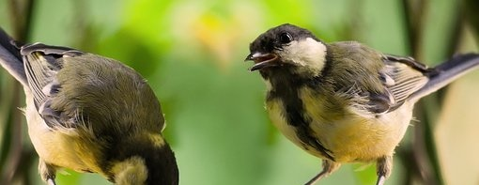
“Morphogenic Fields”
z
Rupert Sheldrake

Slide 10
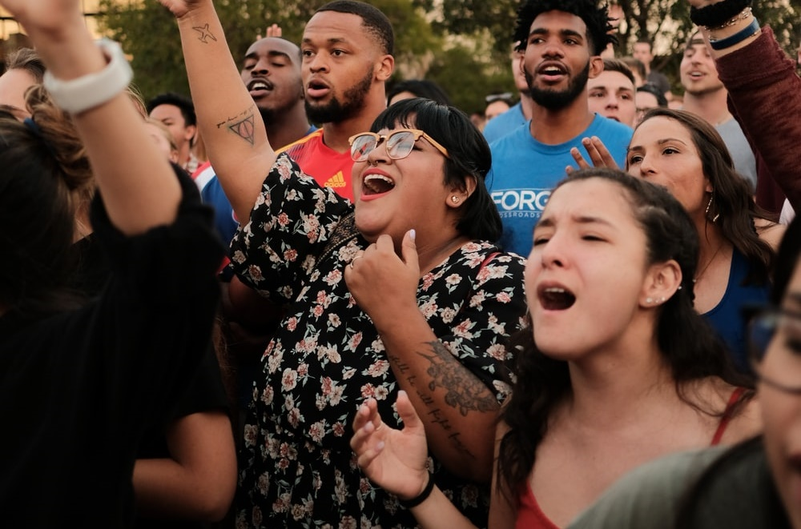

Slide 11
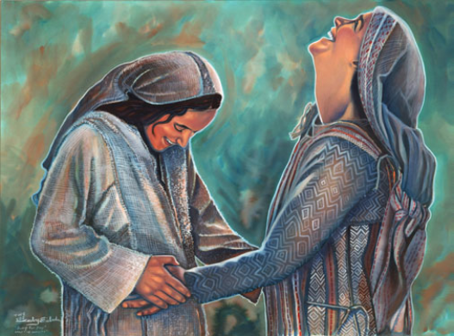
SPACIOUSNESS
There is a space in myself for you.
Artist: Corby Eisbacher www.artbycorby.etsy.com

Slide 12
CONTEMPLATION
I am aware of what is before me and how connected I am
to all that is.

Slide 13
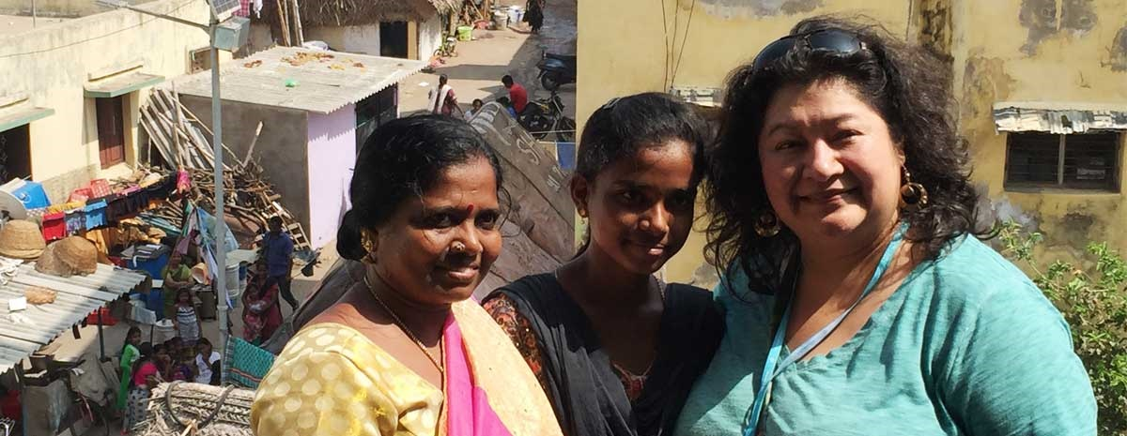
COMMITMENT
I focus and set my intention in order to hold the vision
.

Slide 14
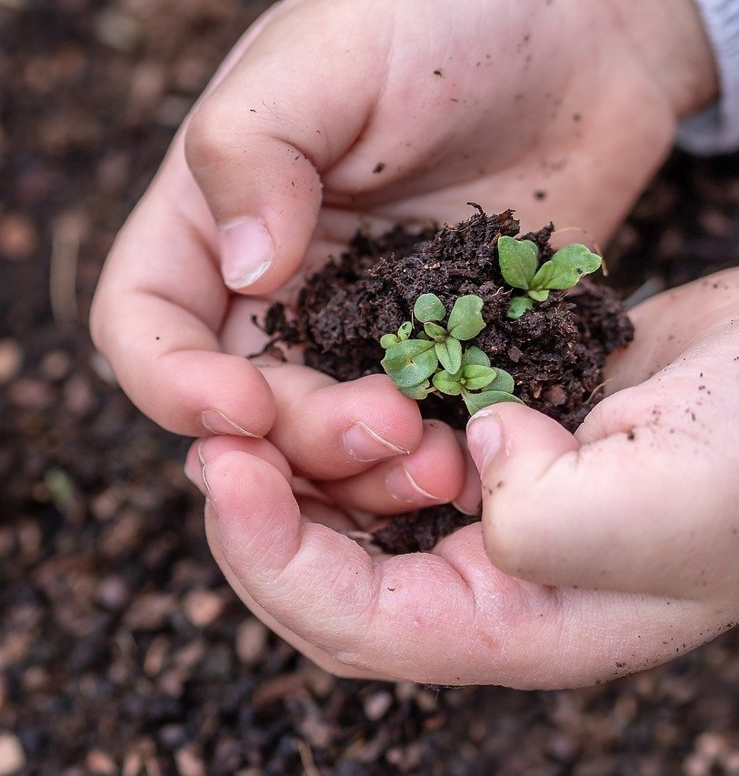
I have the capacity to envision that which does not exist and to invite it to take form.
IMAGINATION

Slide 15
z
For God so loved the world that he gave his only Son…
John 3:16

Slide 16
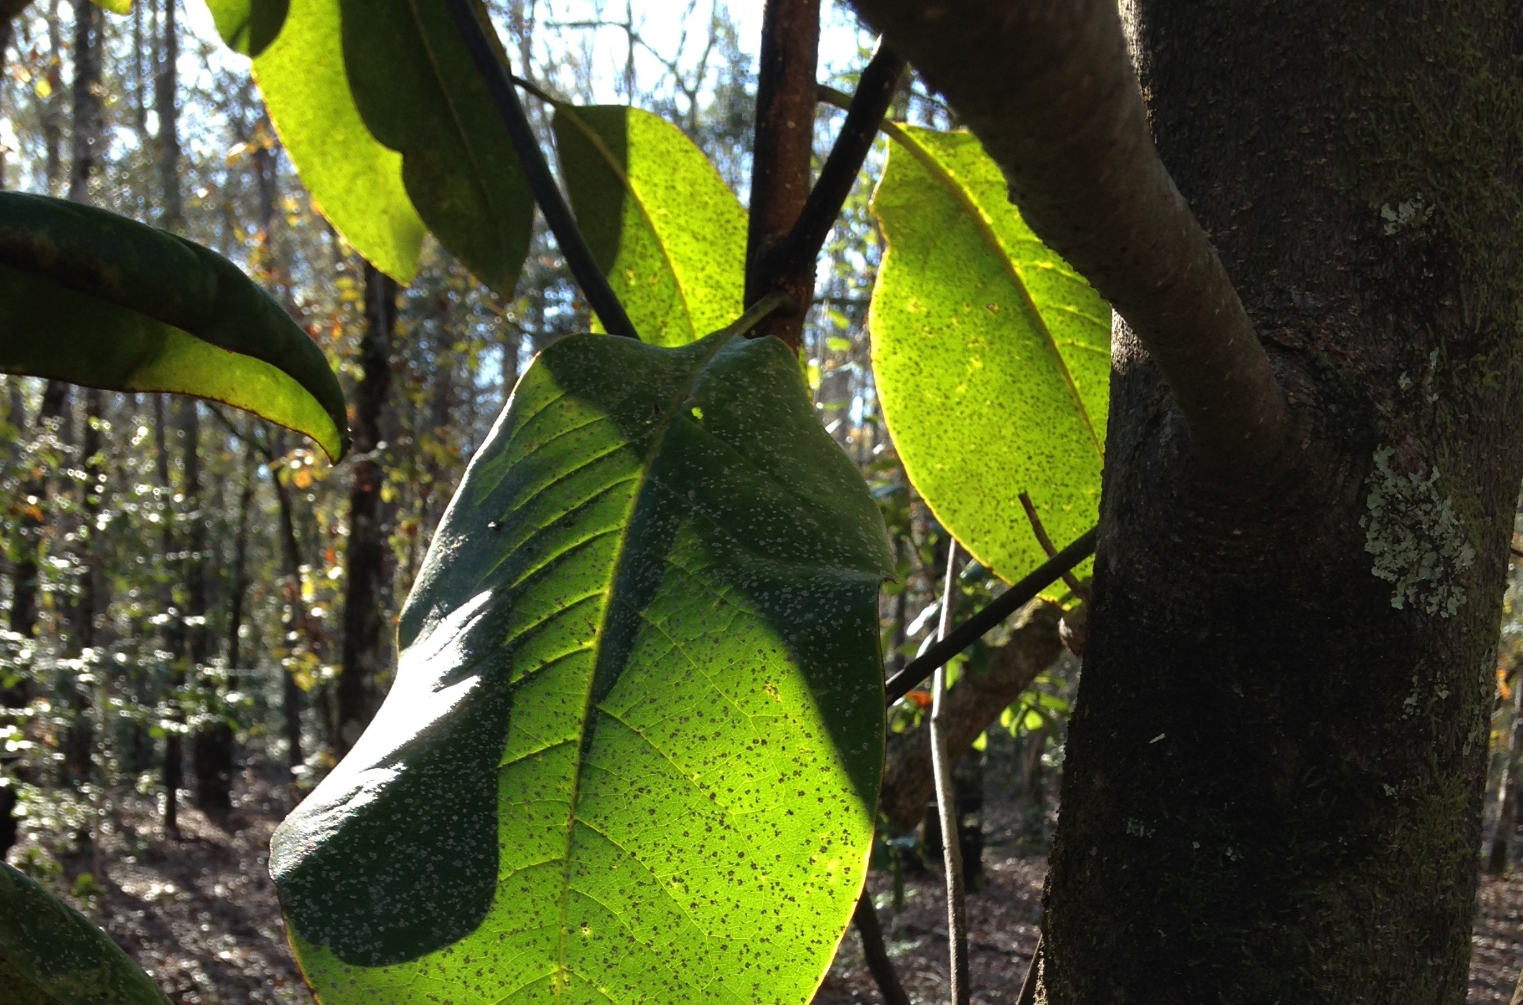
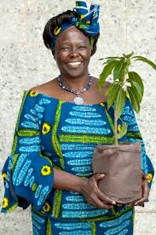
IMAGINATION
Wangari Maathai

Slide 17
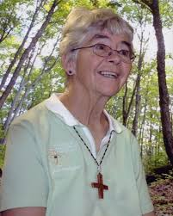
Dorothy Stang SND de Namur
COMMITMENT
I focus and set my intention
in order to hold the vision

Slide 18
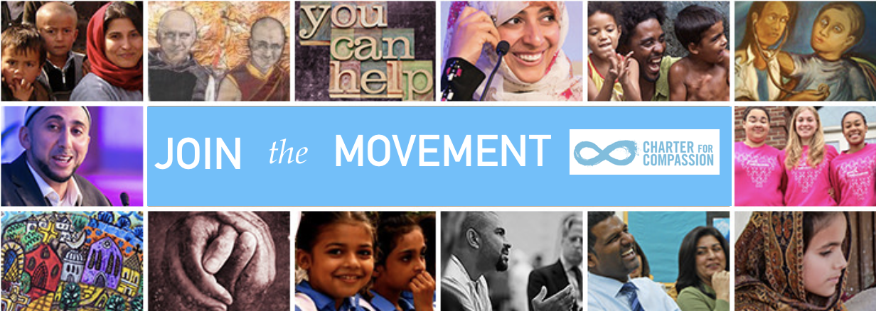
CONTEMPLATION
I am aware of what is before me and how connected I am
to all that is.

Slide 19
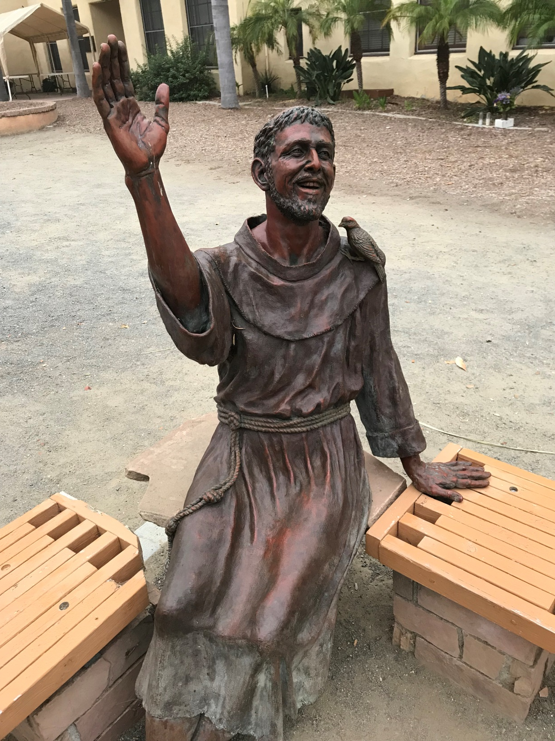
SPACIOUSNESS
…not above other
or apart from others
but deeply related to others
- Ilia Delio
St. Francis of Assisi, Old Mission San Luis Rey
Oceanside, CA

Slide 20
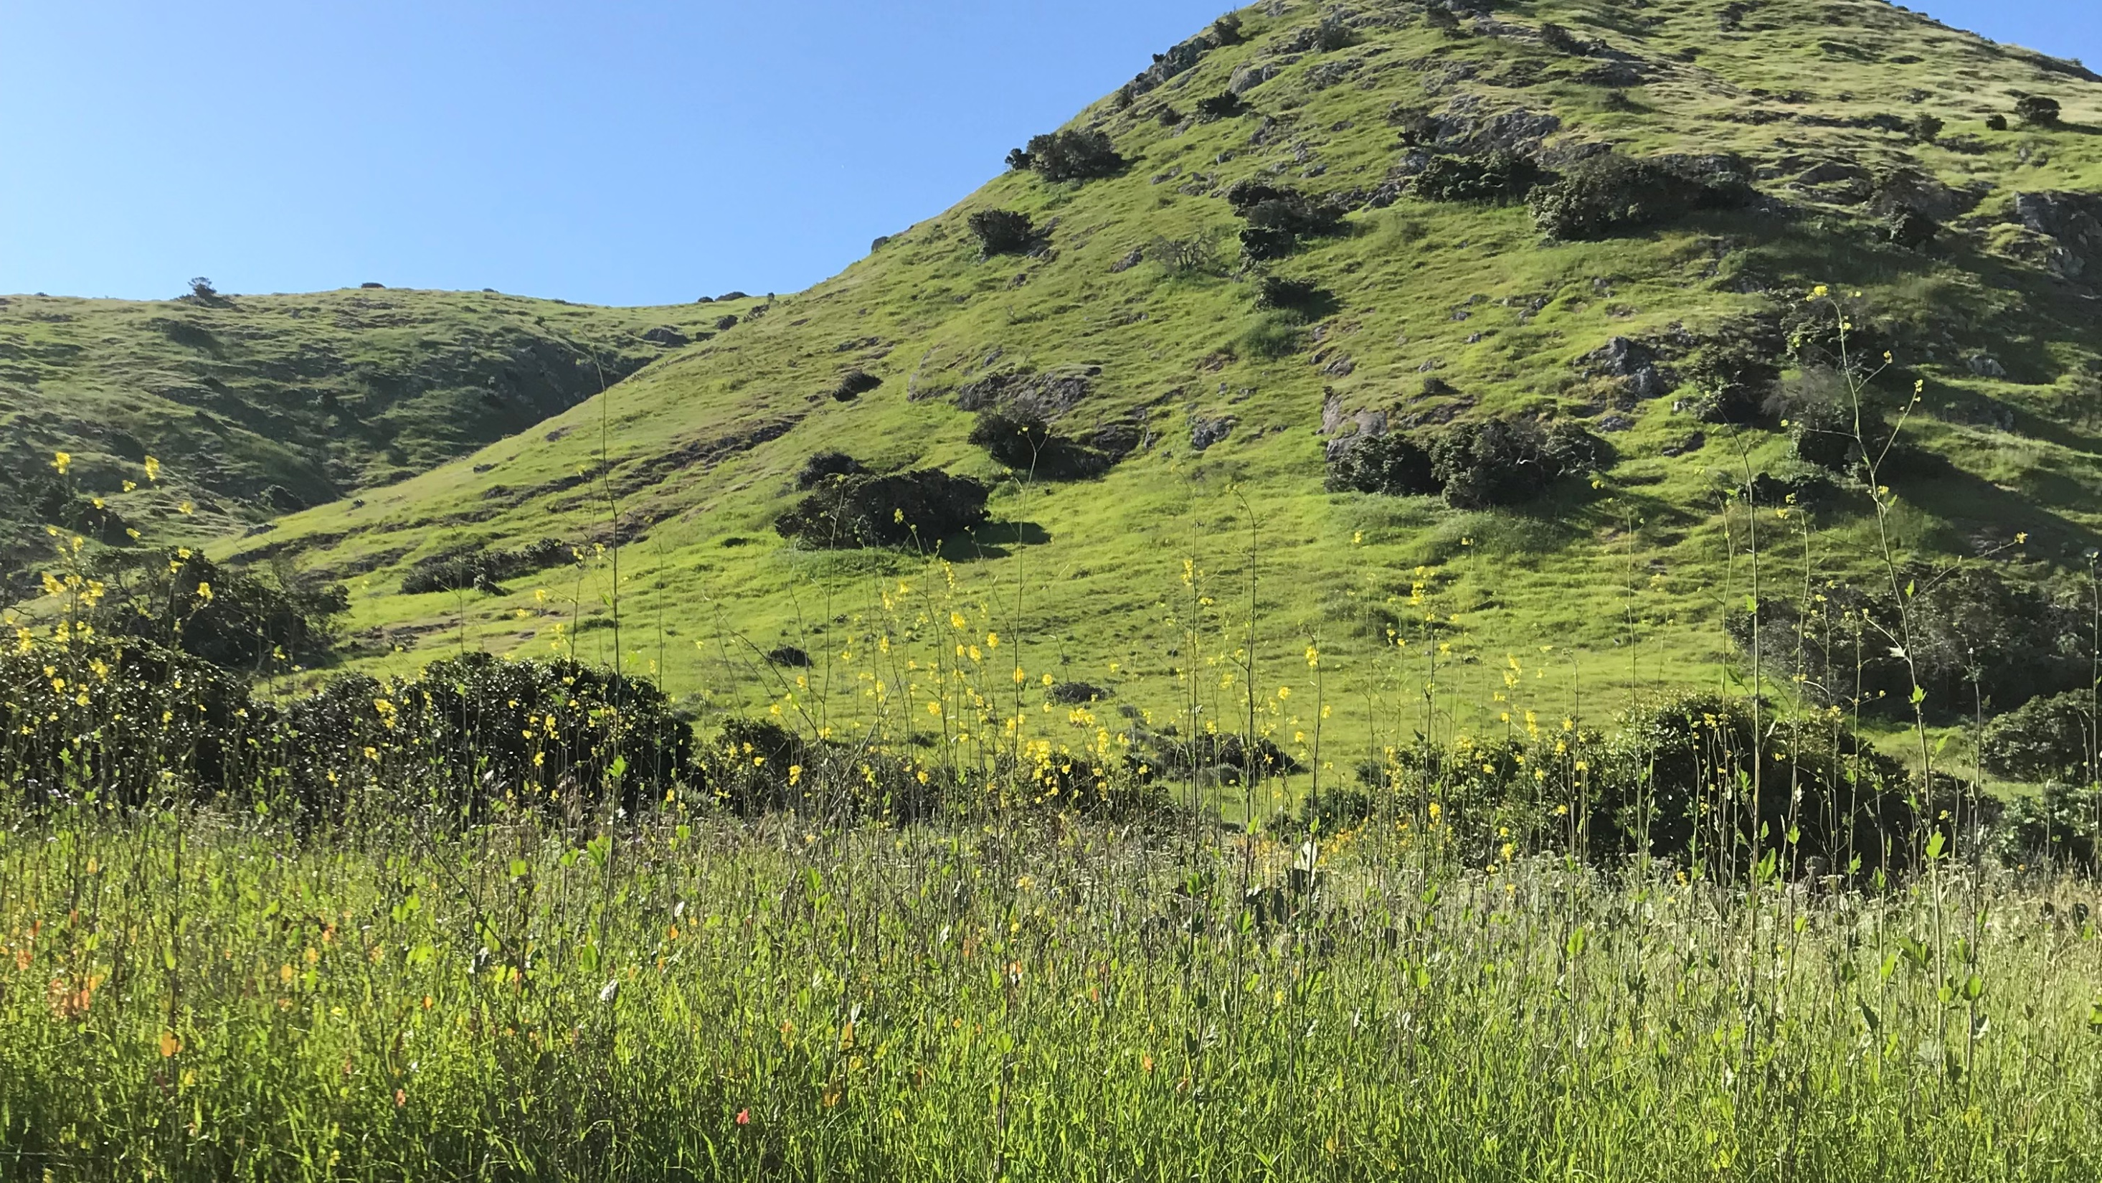
SPACIOUSNESS
“He emptied himself…” (Phil 2:7)

Slide 21
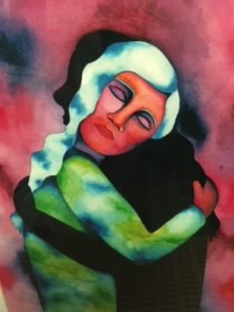
Our shadow is “mixed with our genuine desire to care.”
Boundless Compassion
“Embracing Our Shadow” Rita Loyd © 2001
www.NurturingArt.com

Slide 22
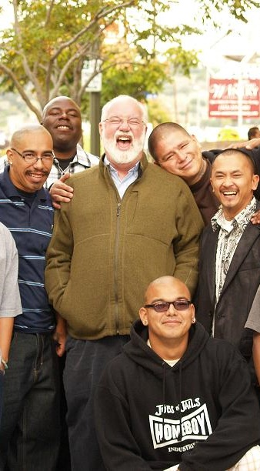
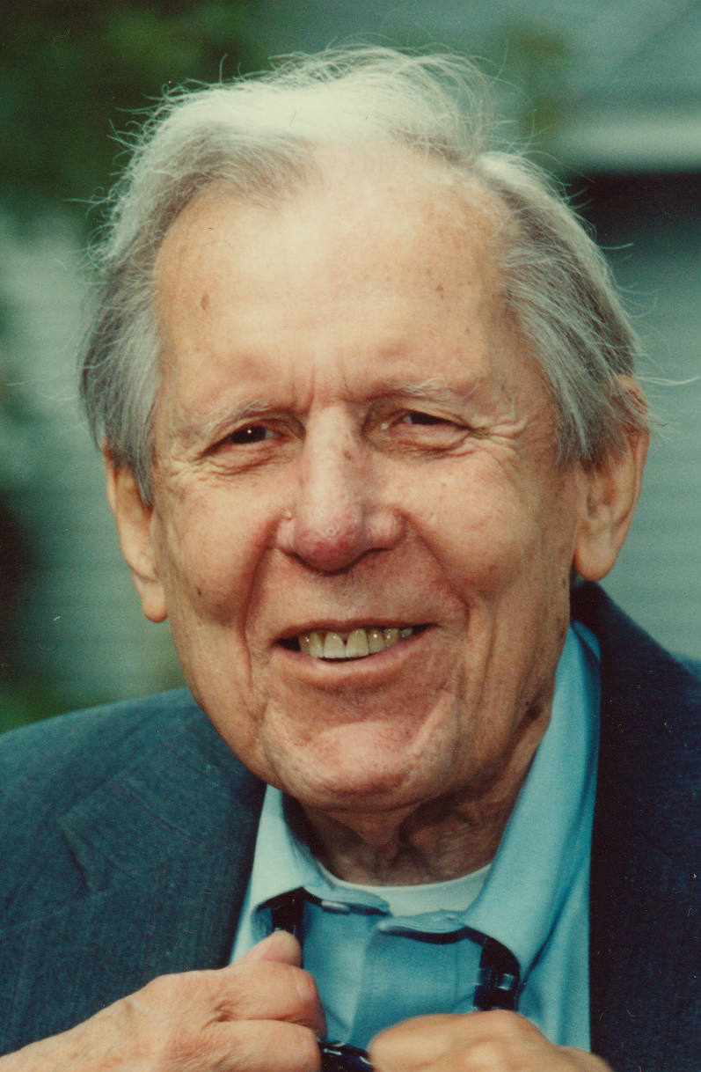

Slide 23
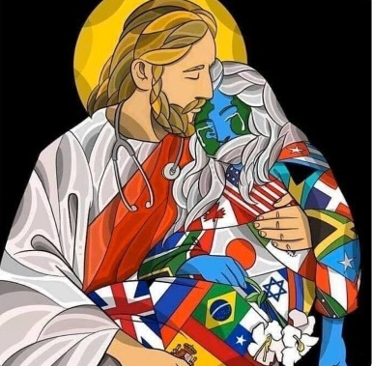
This Presence is so immense, yet so humble…
I know that I am known.
Everything in my life is transparent in this Presence.
It knows everything about me…
and still loves me infinitely.
This Presence … is non-judgmental, self-giving,
seeking no reward, boundless in compassion.
It is like coming home to a place I should never have left,
to an awareness that was somehow always there, but which I did not recognize.
Thomas Keating, Open Mind, Open Heart

Slide 24
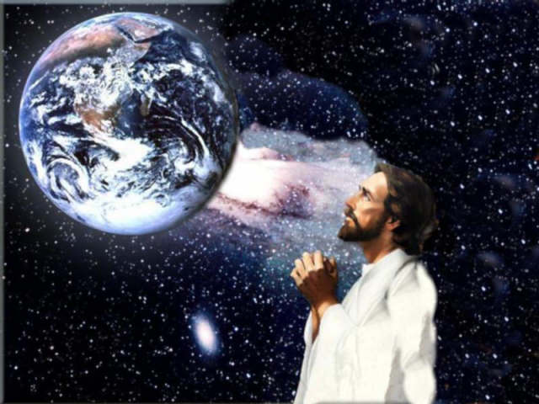

Slide 25
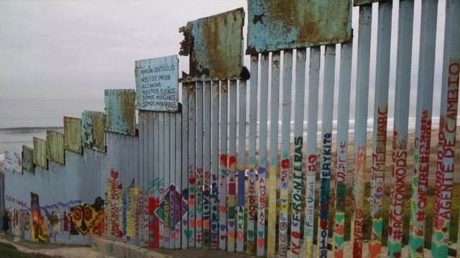
“Will you trust that your loving presence and good deeds
contribute to the dream of peace
and toward the diminishment of travail in our world?”
Joyce Rupp

Slide 26
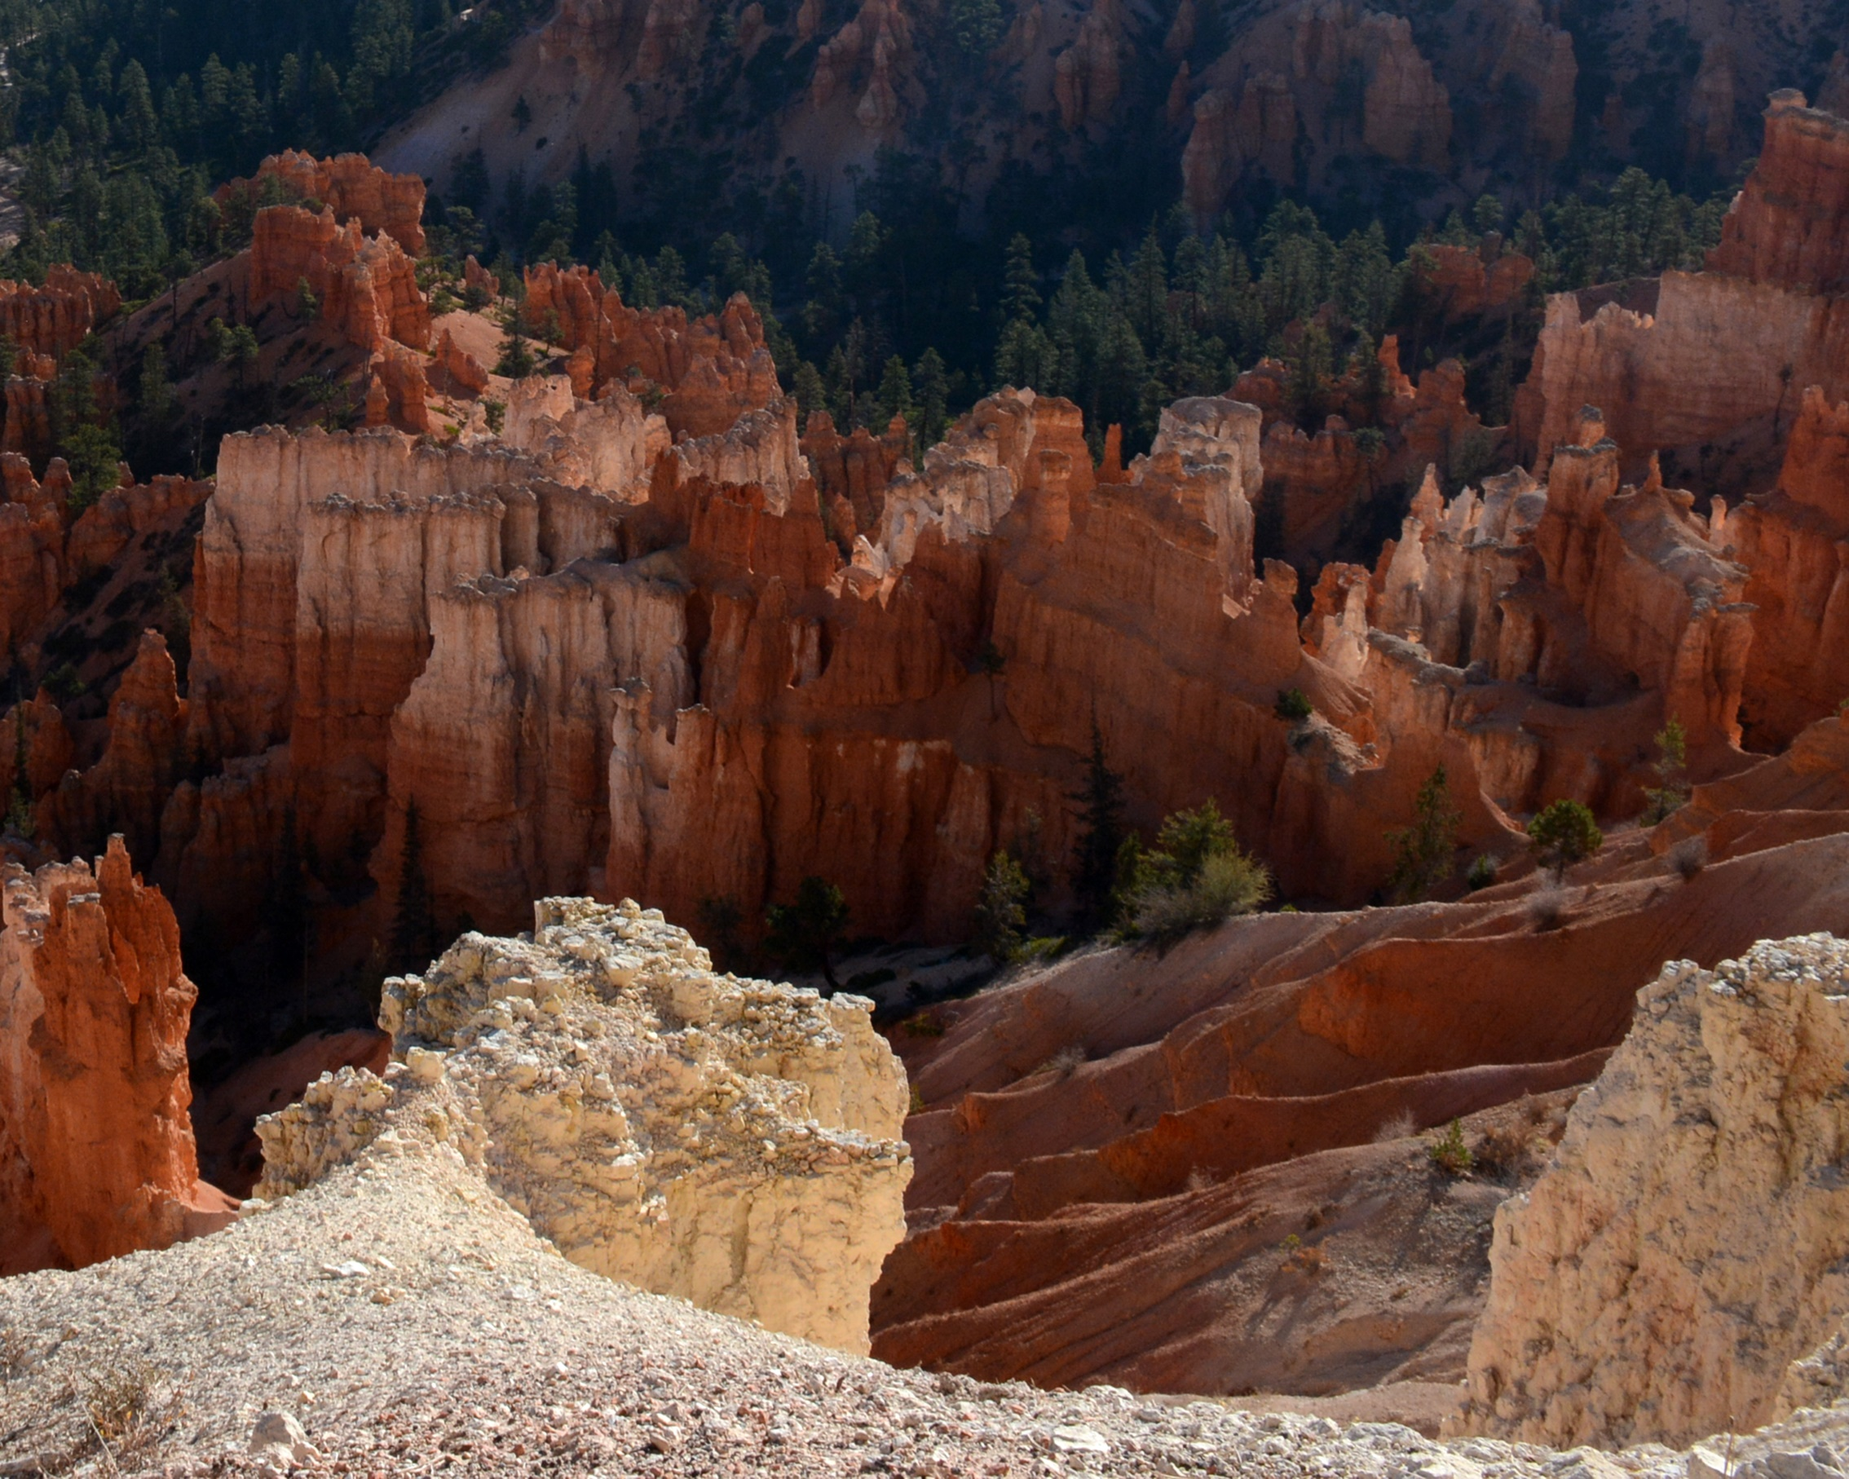
Don’t ask the mountain
To move, just take a pebble
Each time you visit.
John Paul Lederach
Don’t ask the mountain
To move, just take a pebble
Each time you visit.
John Paul Lederach

Slide 27
Photo Acknowledgements:
Frame 2, 3, 4, 5, 6, 9, 10, 14 – Courtesy of Pixabay
Frame 7, 23, 24 – unknown source
Frame 13 – unbound.org
Frame 15, 20 – Mary Dean Pfahler
Frame 16, 22 – womenscenter.unc.edu
Frame 17, 22 – notredamehealthcare.org
Frame 18 – hopeintheheart.org
Frame 19 – Mission San Luis Rey, Oceanside CA
Frame 22 – Greg Boyle: americamagazine.org
Thomas Berry: Photo by Lou Niznik, Courtesy of the Thomas Berry Foundation
Frame 25 – Sisters of St. Joseph of Orange
Frame 26 – Thomas J. Pfahler

Slide 28
Metta: A Simple Loving Kindness Meditation
May I (you, all beings) be filled with loving kindness.
May I (you, all beings) be free from suffering.
May I (you, all beings) receive what I (you, they) need.
May I (you, all beings) be at peace.

