Slide 2
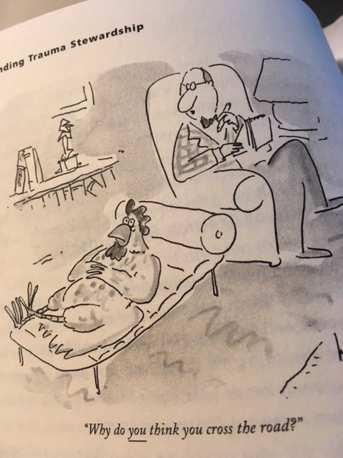

Slide 3
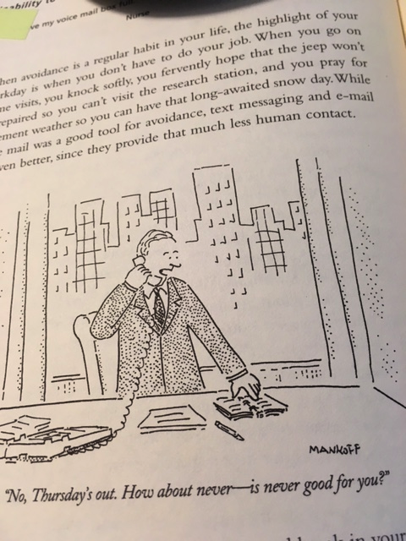

Slide 4
Compassion fatigue = the stress and strain
due to caring for others who suffer
Burnout = daily stress and strain from being
overworked in any aspect of life
(Christopher Germer)

Slide 5
When you sleep next to the cemetery, you can’t cry for everyone who dies.
~ Russian proverb

Slide 6
“an empath”
Overly emotes, takes on emotions of others
Becomes the focus of attention
Cannot have objectivity
Loss of boundaries (emotional, social…)
Karla McLaren, The Art of Empathy

Slide 7
Conscious complaining
“a quick lube for your soul”
Karla McLaren, Empathy

Slide 8
If I come to you in pain and you end up with the same pain
all we have done is add to the world’s suffering….I want
you to understand my pain, to respond to it deeply,
but not take it on yourself. I want you to help me see what
you see and what I cannot see… Mirror my experience,
but don’t embrace it as your own.
~ Rabbi Rami Shapiro

Slide 9
“attachment fatigue…
“We wear ourselves out
when we’re attached to the outcome
of our hard work, such as the success or recognition.”
~ Christopher Germer

Slide 10
Protect self by more than saying “no.”
Protect self from other’s negativity.
Protect self from unhealthy expectations.
Protect self from being consumed by emotion.
Protect self from false flattery
Protect self from false promises.

Slide 11
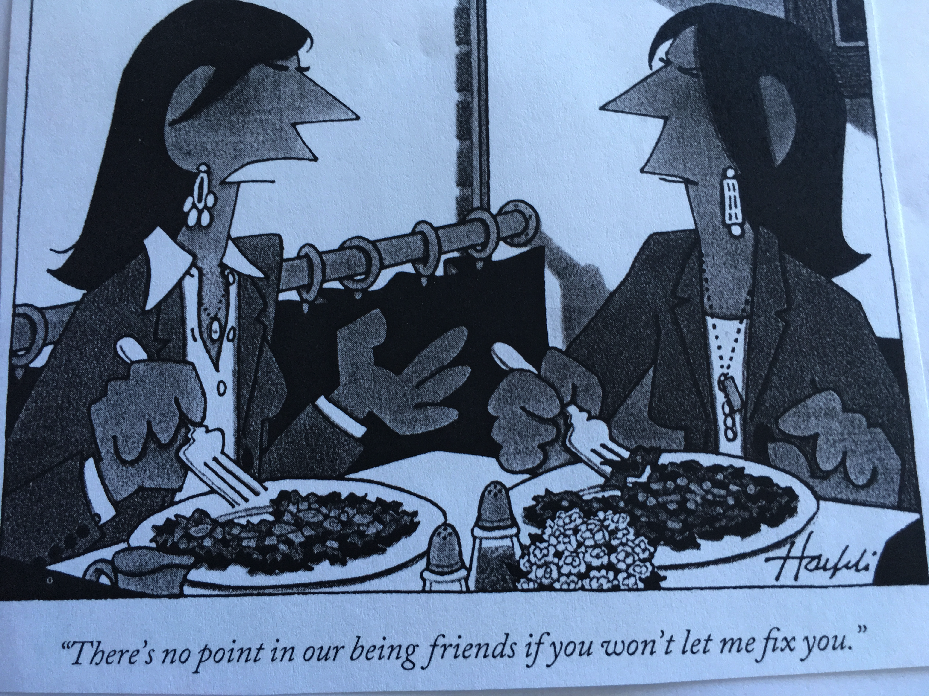

Slide 12
16 Warning Signs of Trauma Exposure Response
Feeling hopeless and helpless
A sense that one can never do enough
Hyper-vigilance
Diminished creativity
Inability to embrace complexity
Minimizing
Chronic exhaustion/physical ailments
Inability to listen/deliberate avoidance
Dissociative moments
Sense of persecution
Guilt
Fear
Anger and cynicism
Inability to empathize
Addictions
Grandiosity

Slide 13
Personal Boundaries, Suzanne LaCombe
Any aspect of our interactions with others,
Includes our relationship with ourselves (self-sabotage)
and with our environment (noise and other stimuli)
“Boundaries reflect our core values, our respect for ourselves and our need for safety and protection. They include being able to say no and mean it, or saying yes and meaning it. They are a way of defining ourselves separately from others.”

Slide 14
What do I need for health of body, mind, spirit?
What is possible now?
Who or what can help me to have this health?

Slide 15
Caring for Self
Faithfulness to daily spiritual practice
Boundaries Boundaries Boundaries
Trust that difficult things can be a source of growth
Have an objective person with whom to share
Awareness of mental scenarios
Befriend emotional/mental turmoil
Attentiveness to physical pain
Get enough sleep, exercise, healthy food
Make positive affirmations

Slide 16
I will believe the truth about myself
no matter how beautiful it is.
I believe in my personal power
to welcome my total self without harsh judgment.
I believe I have an amazing gift
to keep hope alive in the face of despair.
I believe I have the strength of will
to be at peace in a world of violence.
I believe in my miraculous capacity
for both giving and receiving love.
I will believe the truth about myself
no matter how beautiful it is.
(Macrina Wiederkehr)

